Slide 1

Scaling up drug discovery and development using AI & ML
Pr. Pierre Marquet, MD, PhD
Head of UMR1248 Pharmacology & Transplantation

Slide 2

1- The white book on pharmacological research in France
(21 Novembre 2022)
By the “pharmacology and drug sciences” working group of ITMO Heath Technologies

Slide 3
The “Pharmacology” working group
10 experts covering pharmacology, modeling, PK/PD, bio-informatics and new advanced methodologies (NAMs)
INSERM, CNRS, INRAE, Universities and research institutes working together
Pharmacometrics, antimicrobial resistance, organoïds, vectorization and personalized medicine
Multi-
disciplinary expertise
Representation
Key areas

Slide 4
Situation appraisal
Academic innovation
Rapid evolution
Academic research is the main source of innovation in medicine in France and worldwide.
Medicines are evolving rapidly: nucleic acids, cell-based medicines, and tissue-based medicines require the rapid adoption of new technologies.
Preclinical bottleneck
Valorization through biotechs
Preclinical evaluation in animals has low predictive value and does not comply with the 3Rs principle.
Biotech companies must quickly de-risk their drug candidates to attract investors.

Slide 5
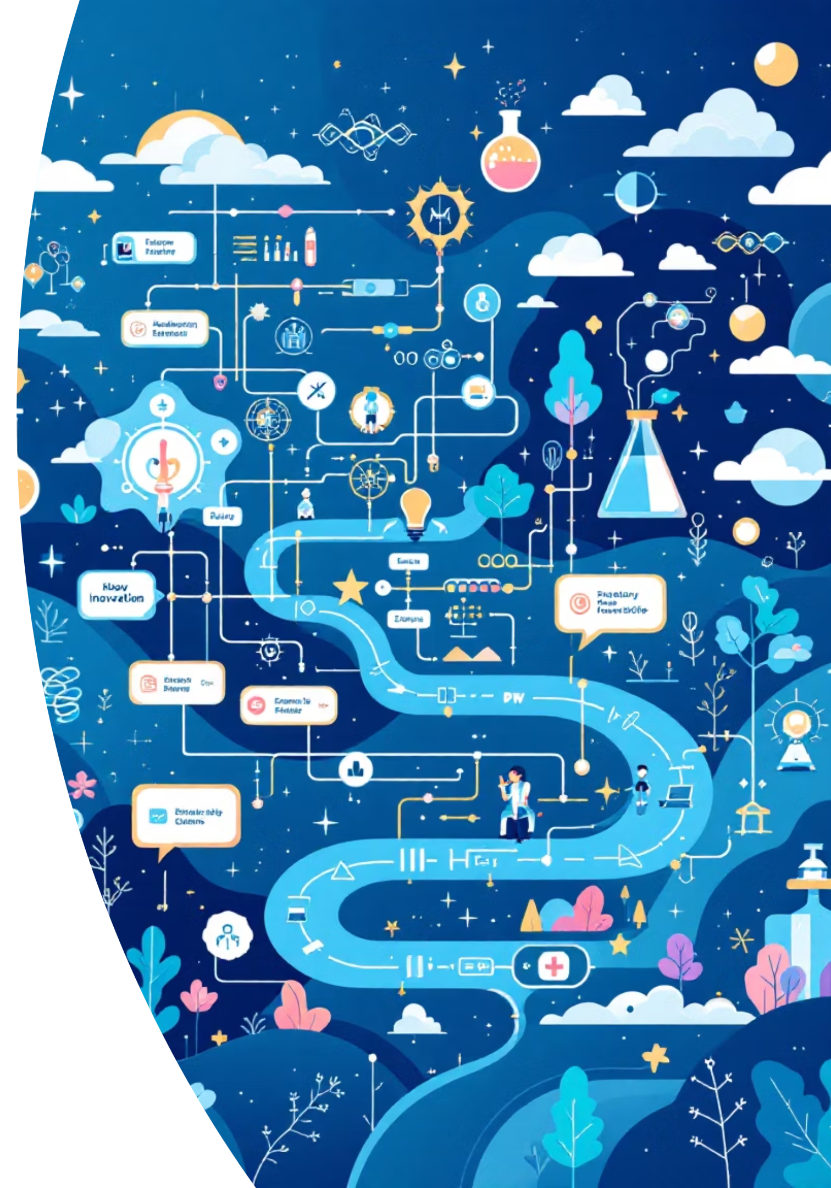




Objectives of the working group
Predictive performance
Improving the predictive performance of models in drug R&D
Easing restrictions
Identifying methodological and technological barriers and propose solutions
Spreading innovation
Exploring, encouraging, and positioning pharmacological innovation in priority programs
Industrial collaborations
Boosting the French industry and promoting collaborations with France Biotech

Slide 6


Work done by the WG
01
Mapping
Academic teams and technology platforms
02
Survey
Online questionnaire for academic teams
03
Analysis
Bibliometrics analysis of the discipline
04
Workshops
Themed workshops with experts
05
White book published on 21 Nov 2022
Restitution meeting
On 23/09/2021

Slide 7
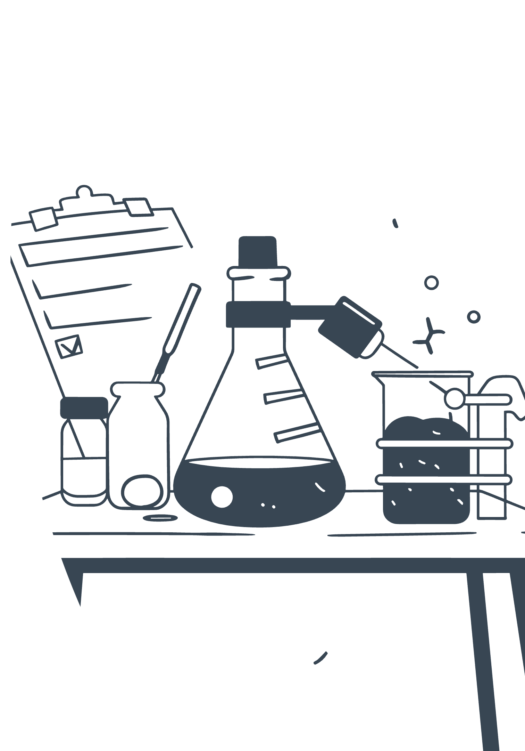
Research Team Survey Results
161
100+
95
Teams Surveyed
Responses Received
Teams Analysed
Research teams identified by ITMO
Including platform submissions
59% response rate achieved

Slide 8
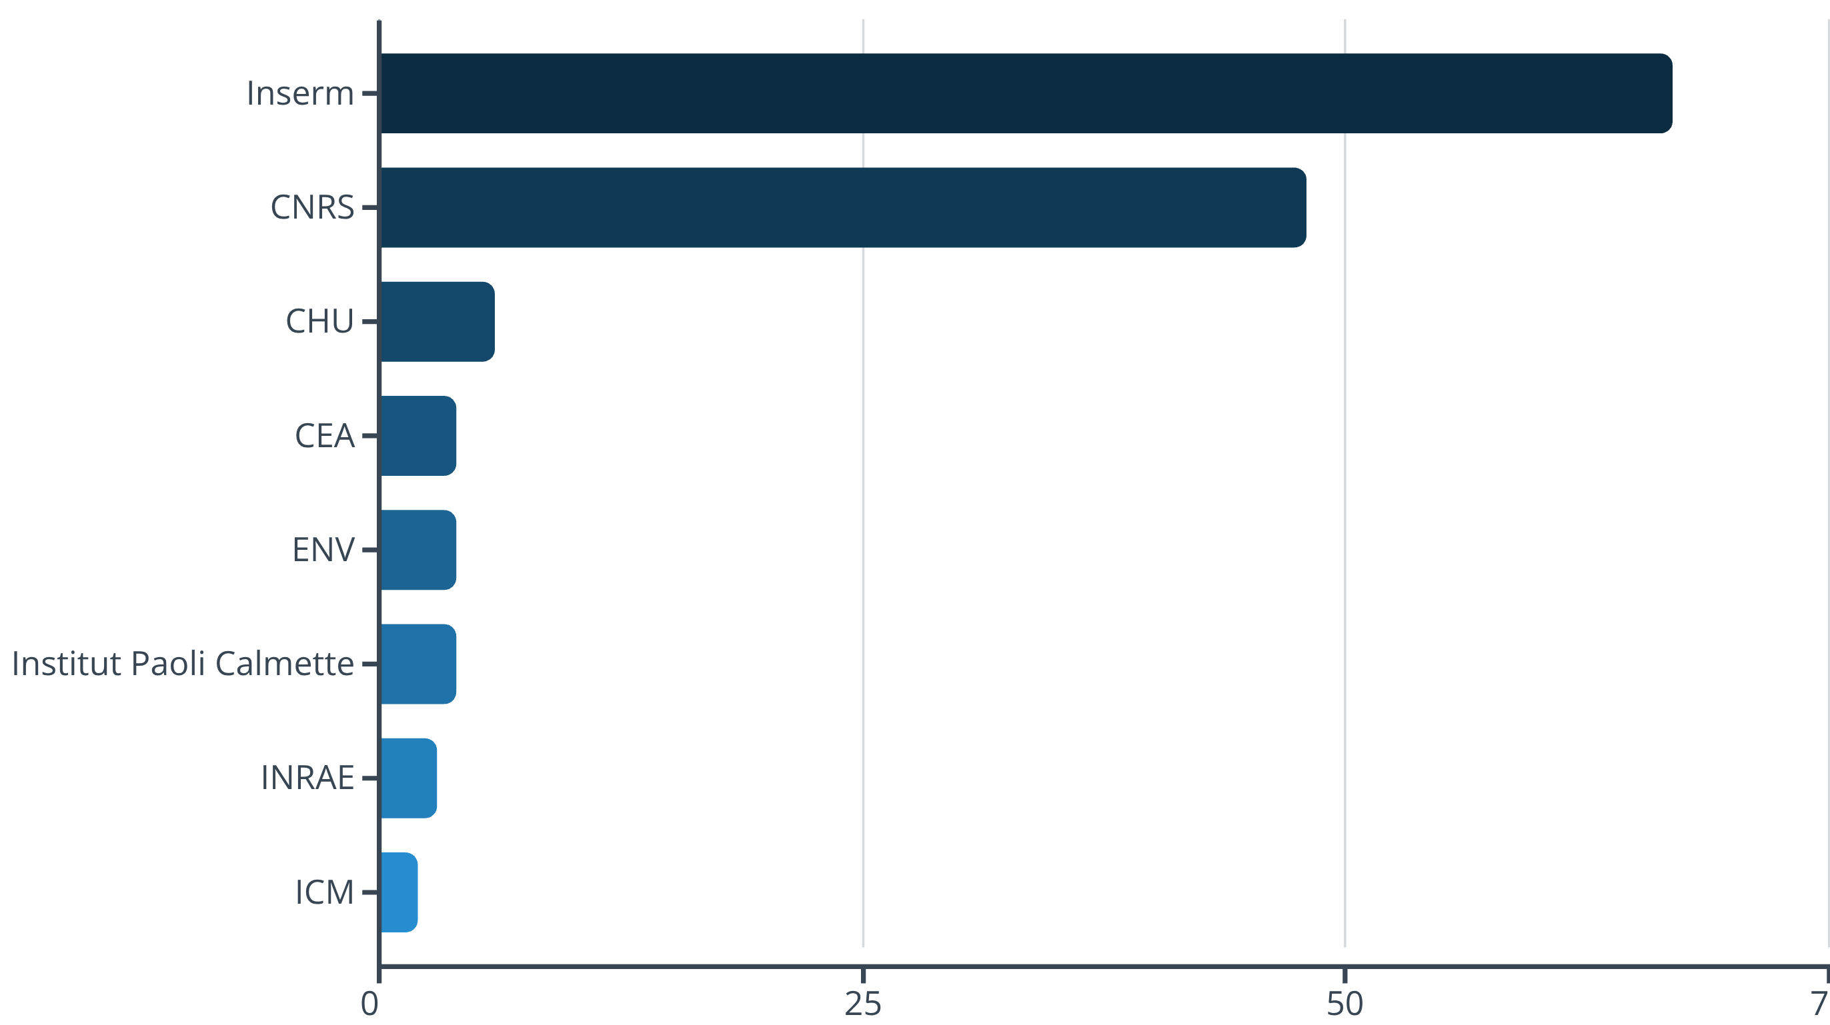
Institutional Distribution
Inserm and CNRS represent the largest institutional contributors, with 67 and 48 teams respectively. Additional participation from CHU, CEA, Institut Paoli Calmette, and other research centres.

Slide 9
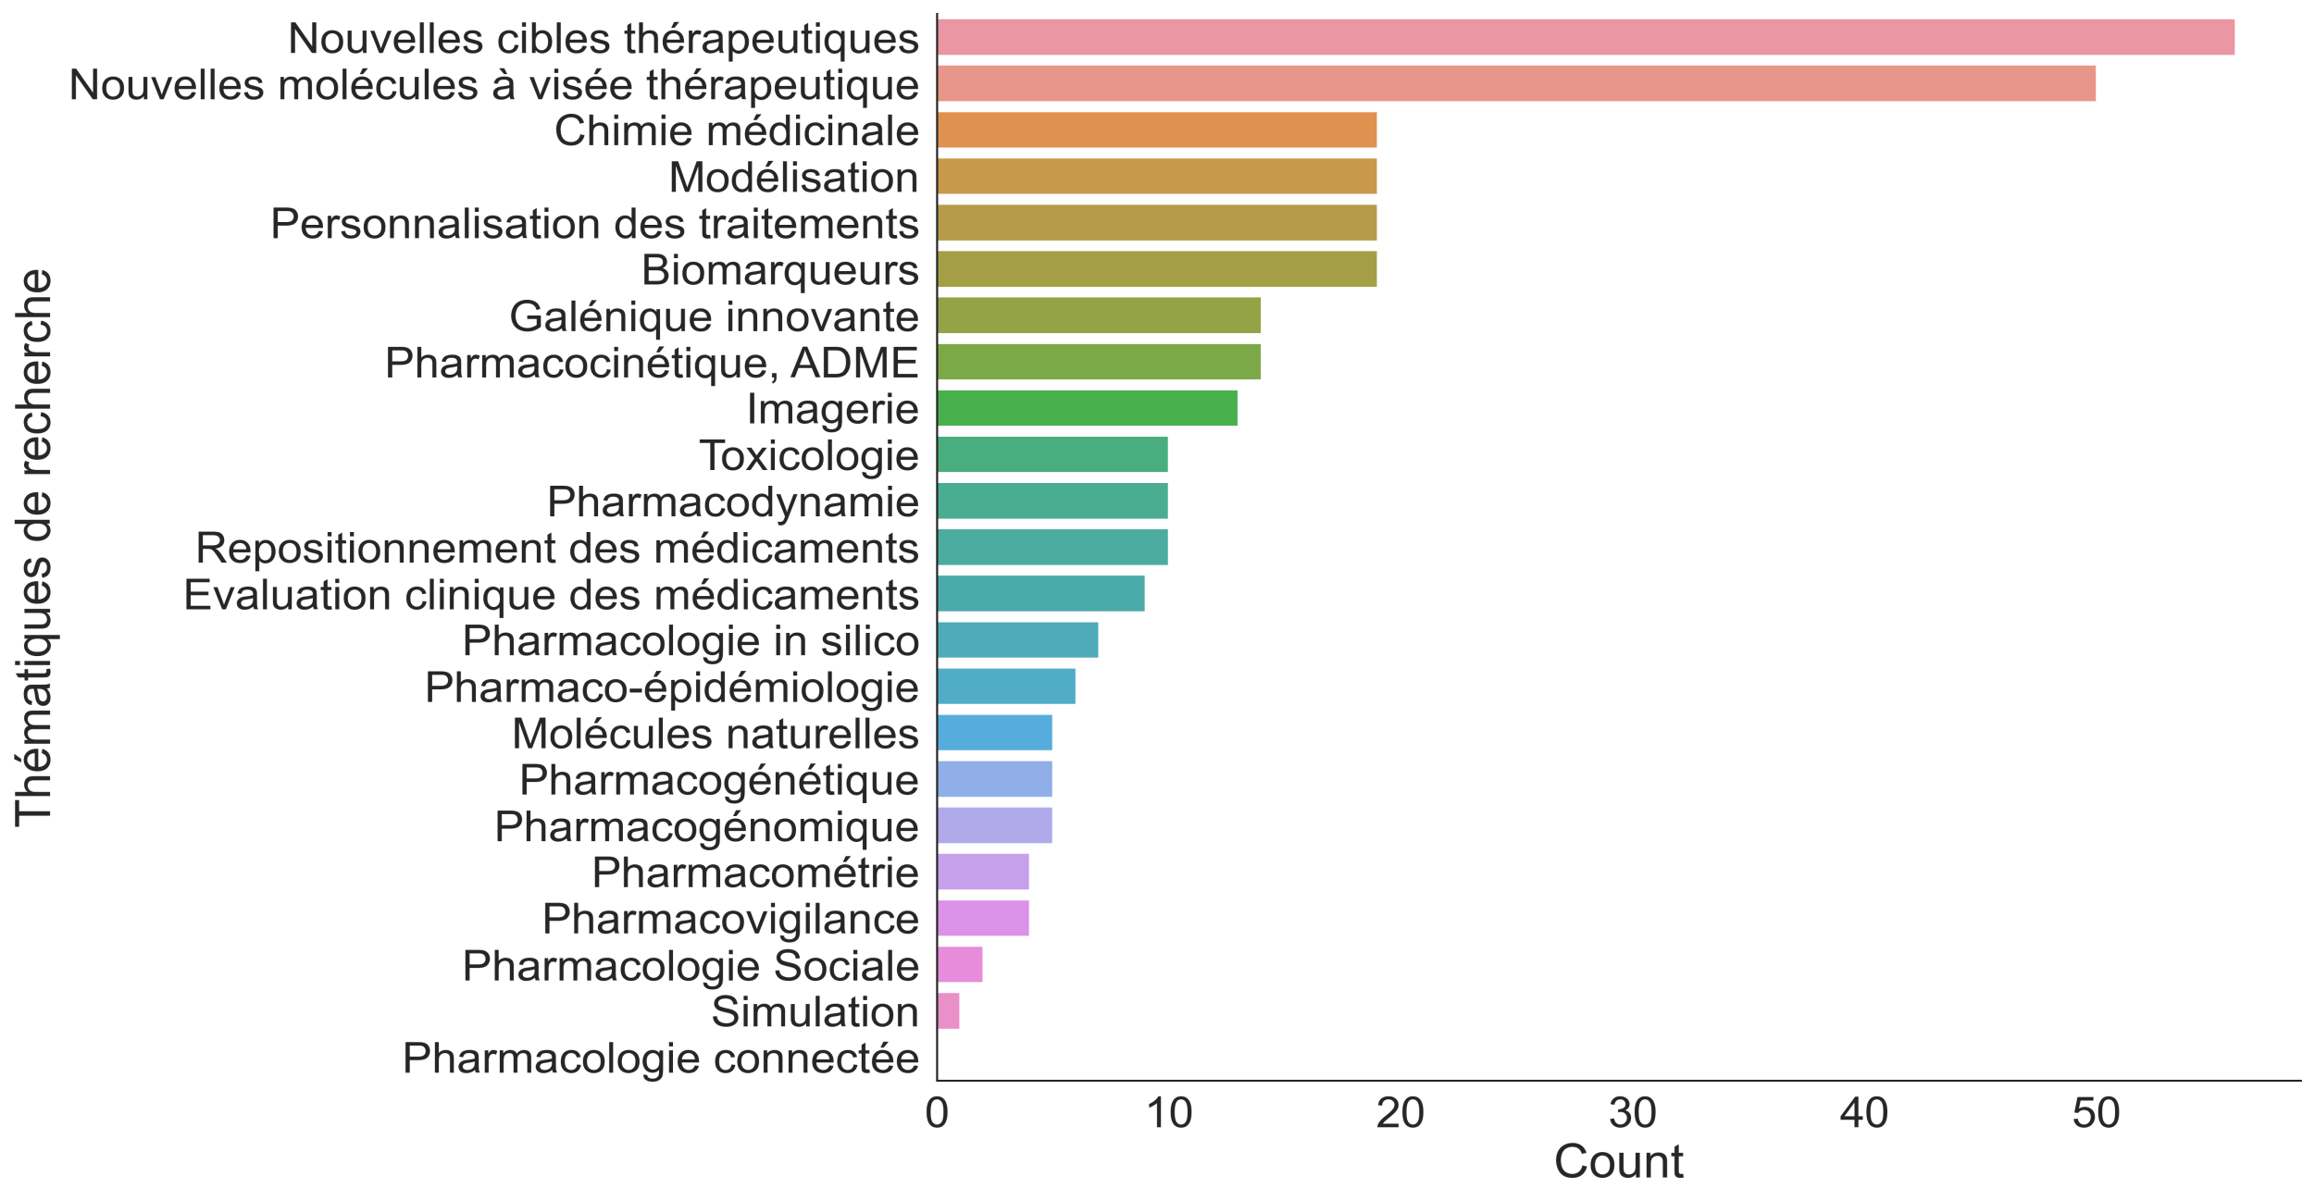
“Indicate your pharmacological research topic by selecting 3 main keywords from the list below” :

Slide 10
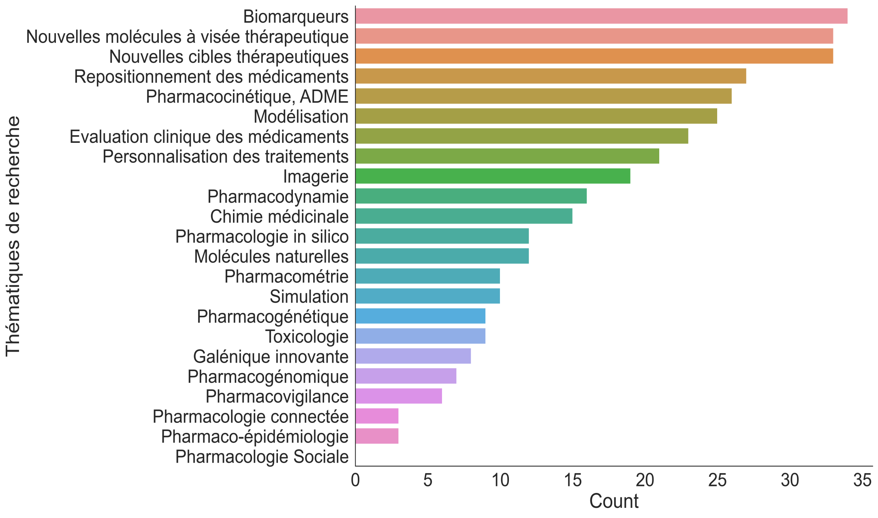
“Specify your pharmacological research topic by selecting 3 secondary keywords”.

Slide 11
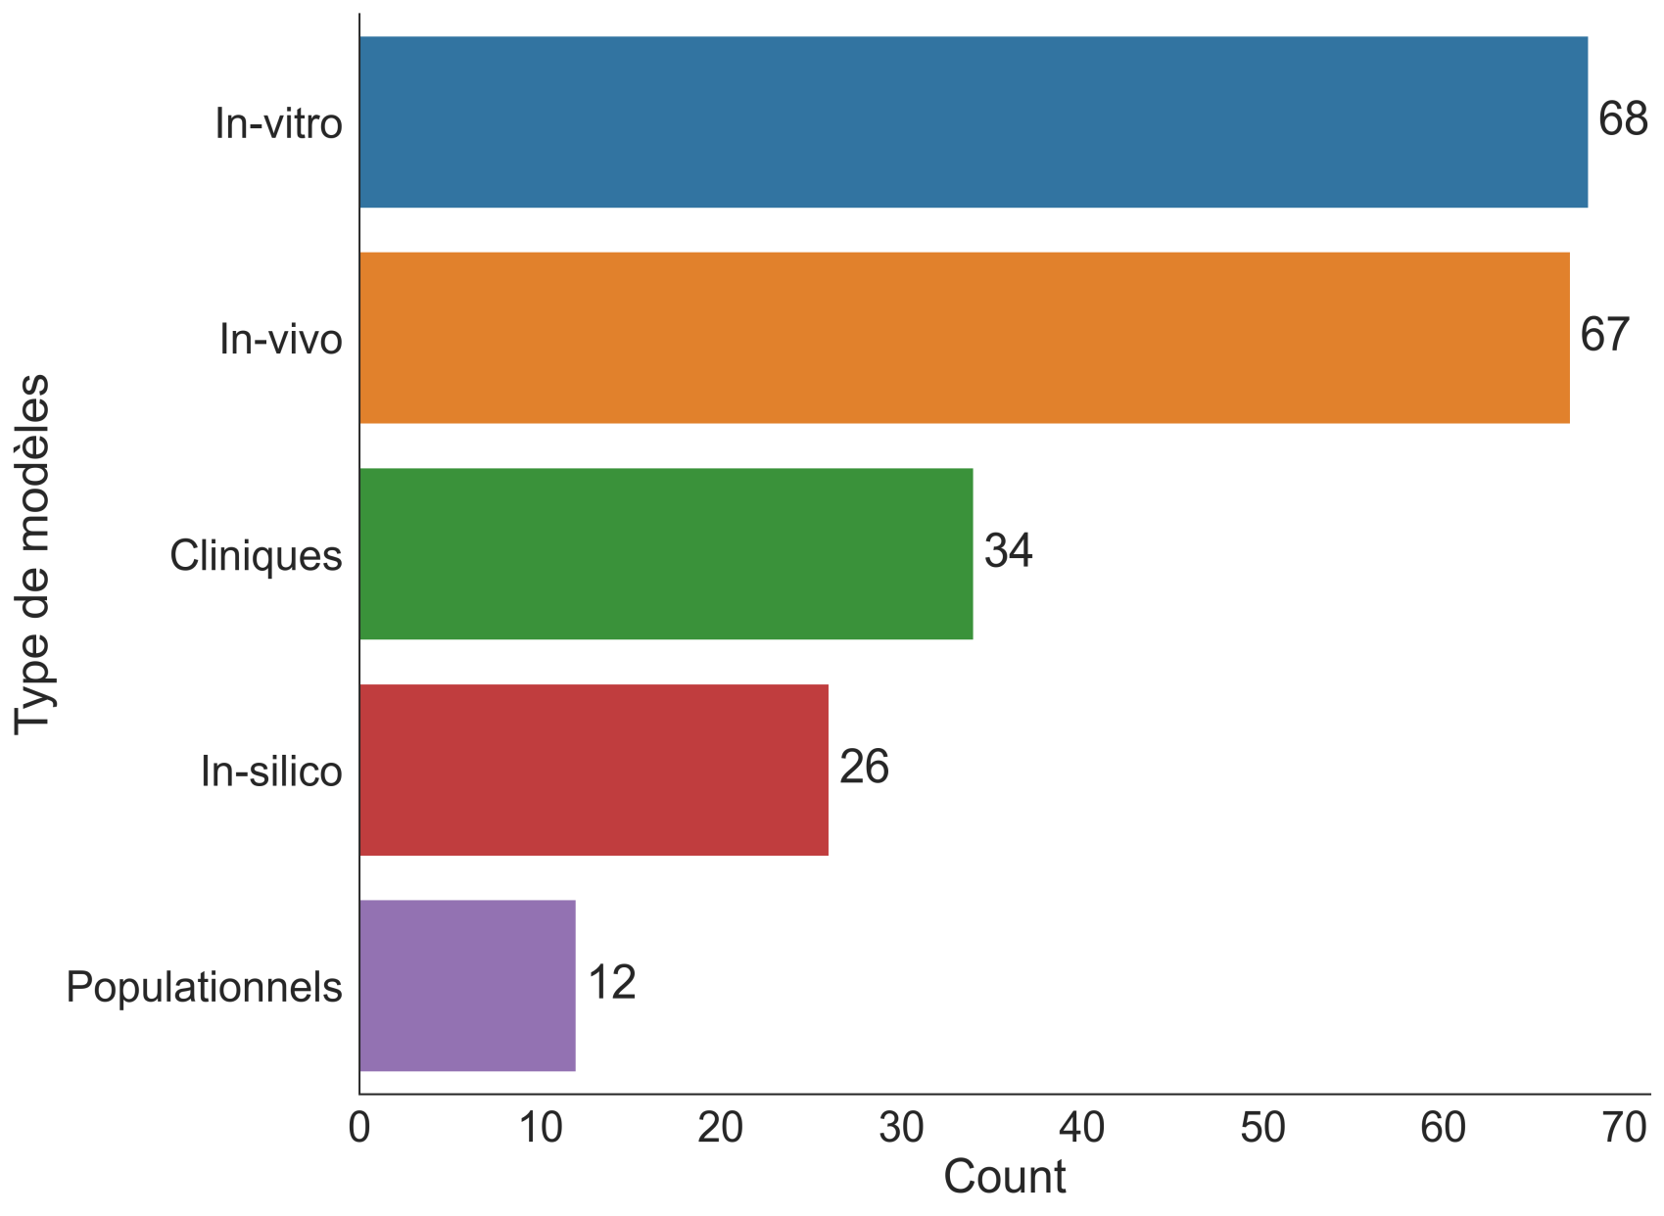
Do you use any of the models in the list below?

Slide 12
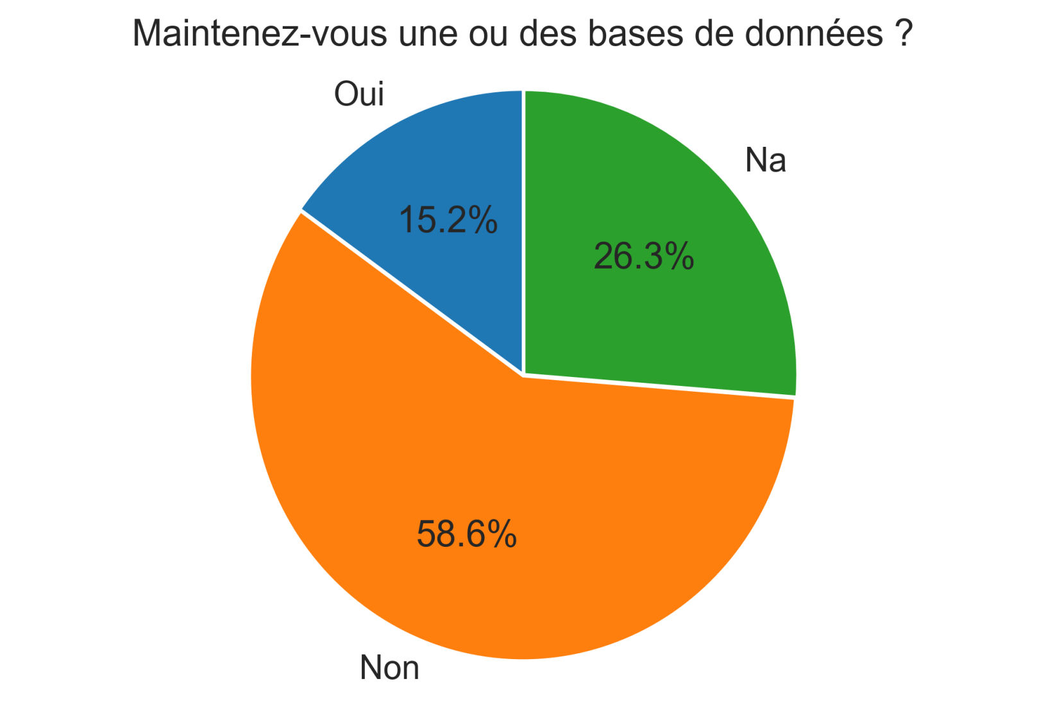
Do you host and maintain at least one research database?

Slide 13
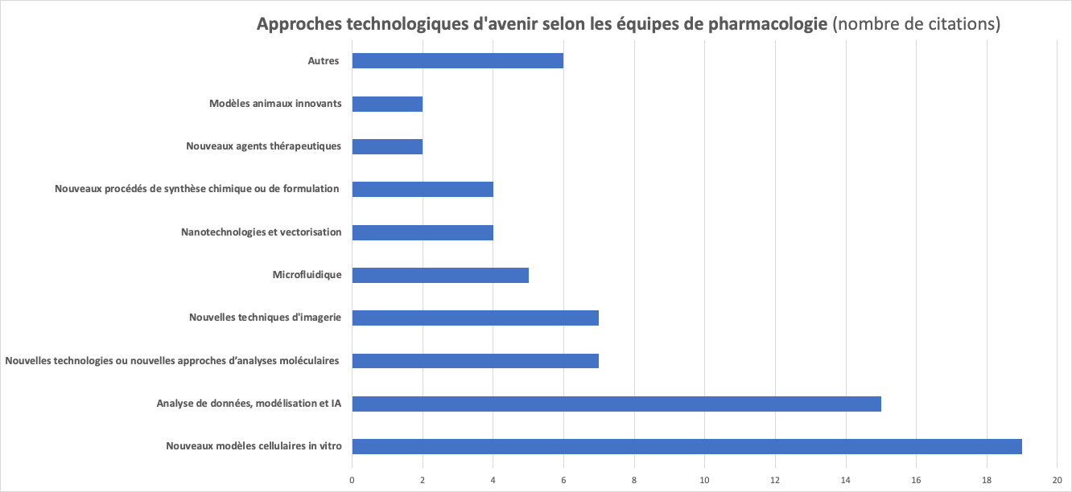
What new technological approaches do you think could change your research in the next five years?
Notes:
En tête : les nouveaux modèles cellulaires (iPS, organoïdes, organs-on-chips …)
Et l’IA
Les nouveaux agents thérapeutiques ne peuvent probablement toucher que les équipes de pharmacologie clinique / pharmacoépidémiologie …
Une surprise avec les modèles animaux innovants. La vague est passée?

Slide 14
AI in pharmacology at UMR1248
“Pharmacology & Transplantation”
(episode 1)

Slide 15
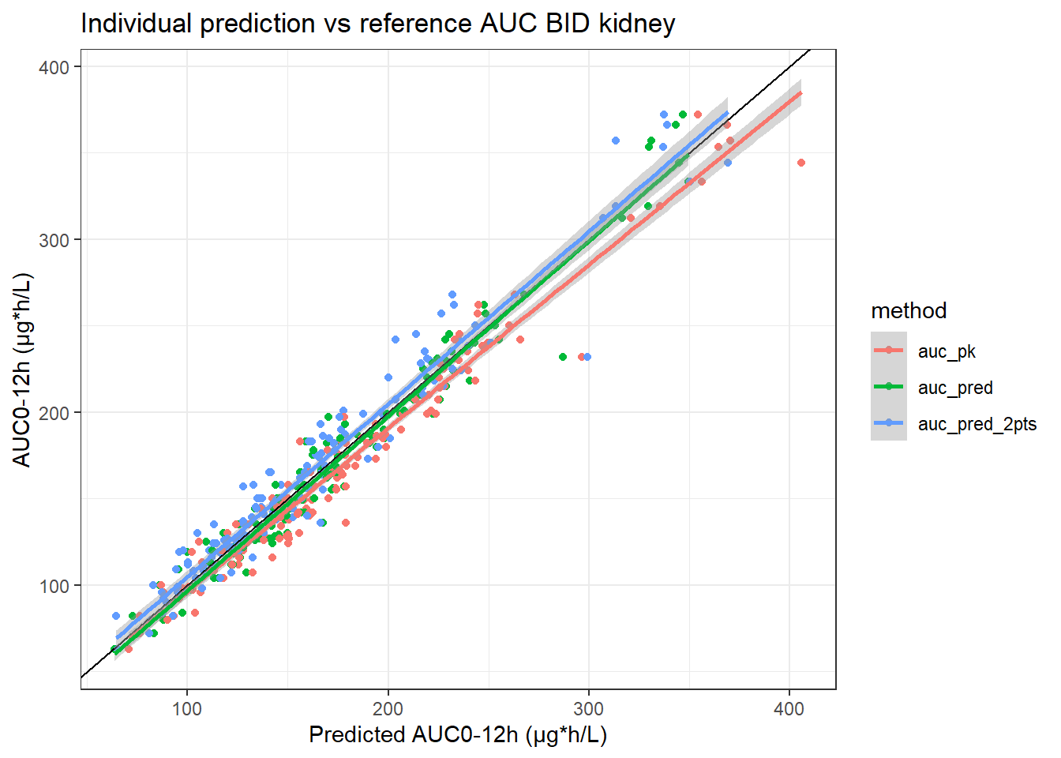
Machine Learning vs. popPK+BE for individual dose adjustment
Model development
  Xgboost trained on our database of ~5000 AUCs/~2000 patients
  to estimate tacrolimus AUC
  Potential predictors: 3 concentrations (C0, C1h, C3h) + covariates
Validation of an Xgboost estimator in an independent database of full PK profiles
  Excellent performance (better than Bayesian estimation), using 2 or 3 blood concentrations
Clinical trial or routine data
POSTERIOR
PRIOR
AUC
Woillard JB et al, Pharmacol Res. 2018

Slide 16
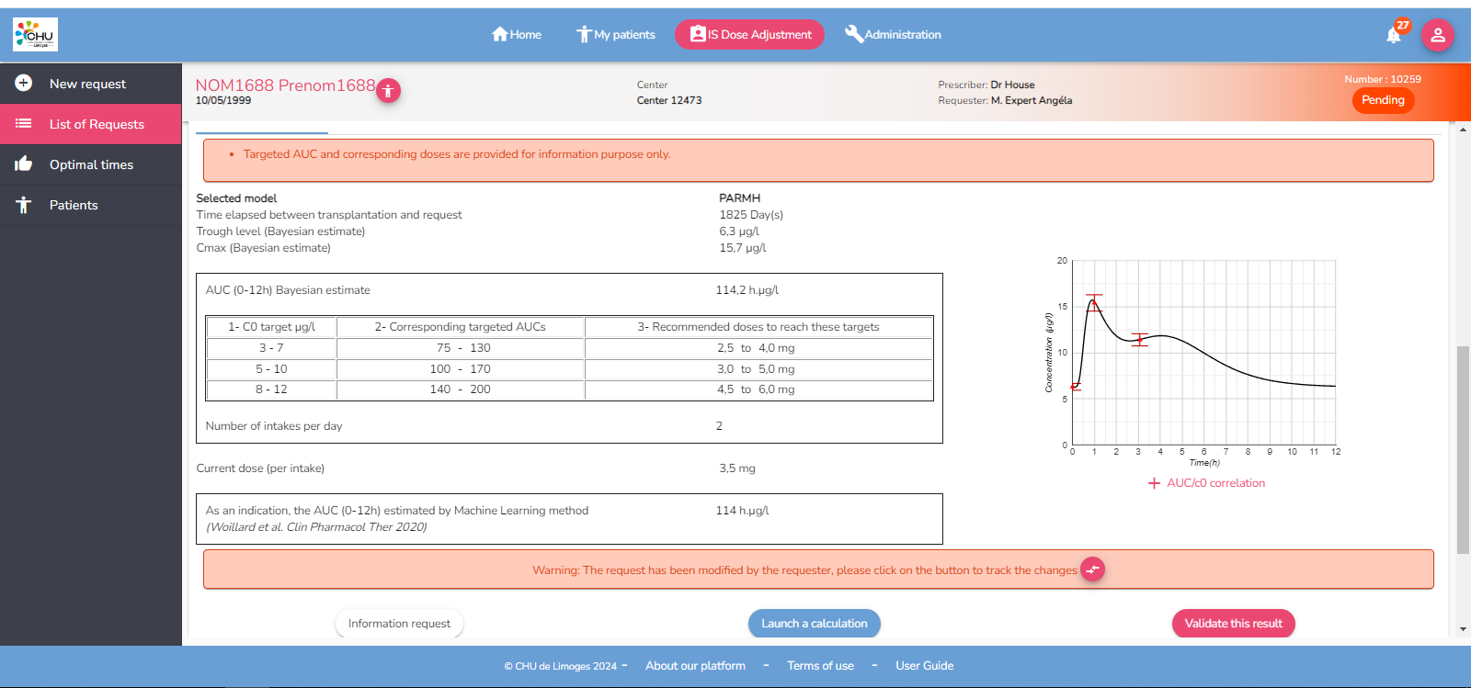
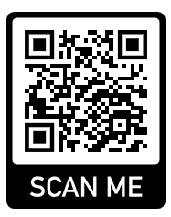
Clinical implementation through our ISBA expert system
(https://abis.chu-limoges.fr/login)
  Bayesian estimate of inter-dose AUC using 3 blood samples in the first 3h
  AUC estimate by ML
  Modeled PK profile

Slide 17
A hybrid model to estimation iohexol plasma clearance CL_{ioh}
CL_{ioh} measures glomerular filtration, but requires many, or very late, blood concentrations → simplification needed
IOHEXOL CLEARANCE
01
Synthetic Data Generation
500 iohexol PK profiles simulated using a literature POPPK model
02
 | Test set | Validation | Validation set | Externe
 | MAP-BE | Hybrid model (Xgboost) | MAP-BE | Hybrid model (Xgboost)
MPE% | -1.0 | 0.7 | -3.7 | -2.2
RMSE% | 6.2 | 5.7 | 14.3 | 10.9
MAP-BE Analysis
All points (REF) and 3 points (LSS) with residual error calculation
03
ML prediction of MAP-BE estimation error
Xgboost vs GLMnet using observed and estimated concentrations and PK parameters
04
Validation
10-fold CV training, test set, and external validation in a patient database
(1) Destere A et al. Clin Pharmacokinet. 2022
(2) Destere A et al. Br J Clin Pharmacol. 2022

Slide 18



JUMP-PHARMA: replacing expert PK modelers by LLM?
Data from patients or simulations
One iteration
V1
V2
Q
Data exploration
CL
Coding Agent (LLM#1)
Codes 1st simple structural model
Model Training
PK parameter estimation
Diagnostic plots…
Likelihood estimation
Model evaluation based on all results
Final PK Model
Codes PK models based on LLM#2 reviews
Hybridizes with NN if necessary
1) Holt et al. NeurIPS proceed. 2024
2) PhD thesis, Racym Berrah (on-going)

Slide 19
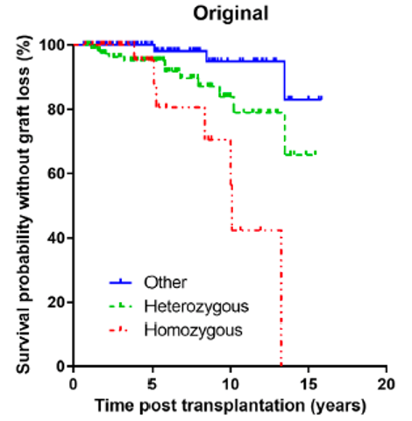
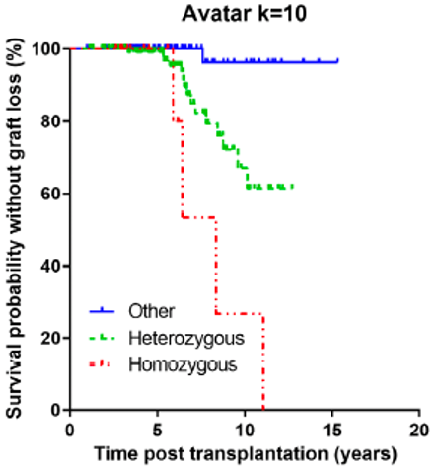
Can synthetic data retain clinical pertinence?
Reproduction of a published pharmacogenetic study (1) using (augmented and de-identified) synthetic data
Aim: influence of an ABCB1 haplotype on kidney graft survival in patients on cyclosporine
Method: data synthesis and augmentation based on the original database using CT-GAN, TVAE or Avatar
Outcome: Hazard ratio (HR) of graft survival between haplotype carriers and. non-carriers
HR from simulated data > original HR, but association correctly reproduced (2)
Woillard et al. CPT 2010
Woillard et al. CPT PSP 2025
To be or not to be, when synthetic data meet clinicalpharmacology: A focused study on pharmacogenetics (Woillard et al CPT PSP 2024)
To be or not to be, when synthetic data meet clinicalpharmacology: A focused study on pharmacogenetics (Woillard et al CPT PSP 2024)
To be or not to be, when synthetic data meet clinicalpharmacology: A focused study on pharmacogenetics (Woillard et al CPT PSP 2024)
To be or not to be, when synthetic data meet clinicalpharmacology: A focused study on pharmacogenetics (Woillard et al CPT PSP 2024)
To be or not to be, when synthetic data meet clinicalpharmacology: A focused study on pharmacogenetics (Woillard et al CPT PSP 2024)

Slide 20
Propositions of the ‘white book’ to structure and foster research in pharmacology and drug sciences

Slide 21

Proposition 1 : Structures and networks
National consortium of experts in innovative technologies in pharmacology: structure of preclinical R&D offering expertise and NAMs
Multidisciplinary expert network
Laboratories developing (or early adopters of) innovative technologies/methodologies
Technological platforms with expertise in drug R&D (NAMs, omics, imaging, AI …)
Network of specialists in drug data and sample collection and analysis
Pharmaco-epidemiology
Collection of samples from patients with severe adverse drug reactions
Clinical cohorts (e.g., Constances) and data repositories (e.g. hospital data storehouses)

Slide 22

Proposition 2 : Data access
Facilitate data access to researchers in pharmacology and drug sciences
Detailed drug registration files (ANSM, EMA) and DARWIN EU data
Improve the predictive accuracy of preclinical models (case studies)
Reduce the attrition of drug candidates across the clinical trial phases
Better evaluate the distribution, elimination and toxicity of new drug types (nano-drugs, mRNA drugs, cell drugs, etc.)

Slide 23



Proposition 3 : towards a “PEPR Pharmacology and Drug Sciences”?
INSERM’s IMPACT-HEALTH program?
PEPR Digital Health +++
PEPR SAMS, MEDOOC … ?
Innovation
Ambitious initiatives
Funding conceptual, technological and/or organizational innovation in pharmacology and drug sciences
Funding large-scale research projects and preclinical development consortia
Training
Funding outgoing mobility of PhD students and post-docs to countries with advanced research in drug R&D

Slide 24
AI in pharmacology at UMR1248
“Pharmacology & Transplantation”
(episode 2)

Slide 25
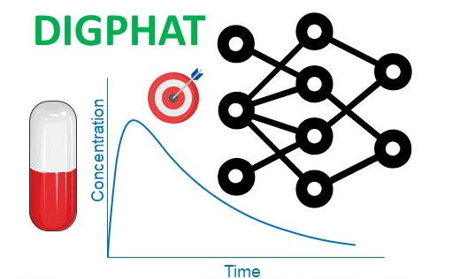
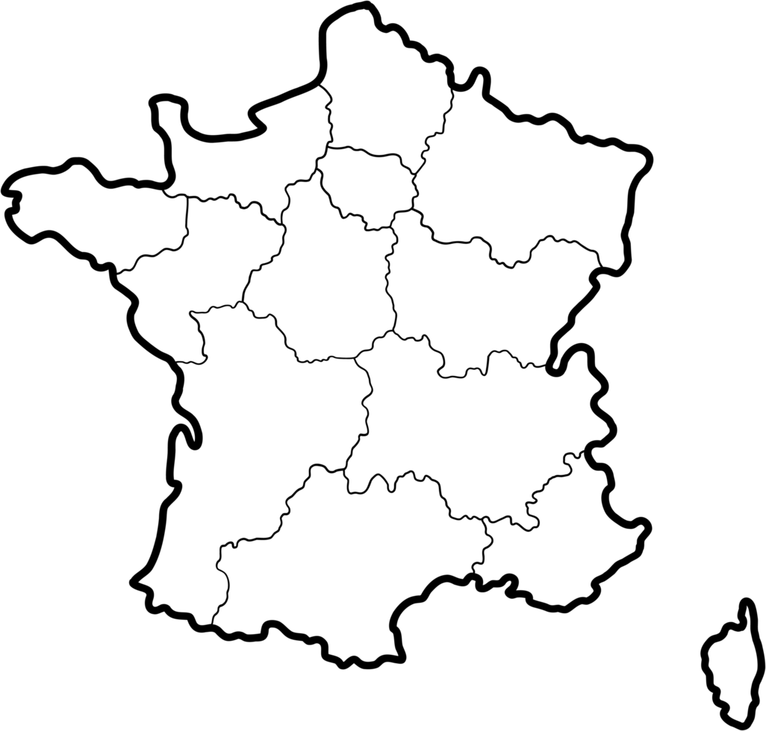
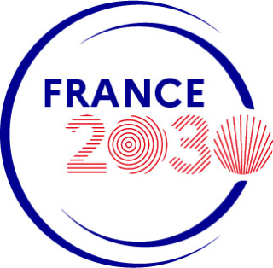
1- Multi-scale and longitudinal data modelling in pharmacology: toward digital pharmacological twins
Digital Pharmacological Twins
PEPR Digital Health
DIGPHAT consortium
(ANR-22-PESN-0017)
Coordinated by JB Woillard, P&T
Woillard et al Digital pharmacological twins: Bridging multi-scale modelling and artificial intelligence for precision medicine: The DIGPHAT consortium, Therapie. 2025

Slide 26
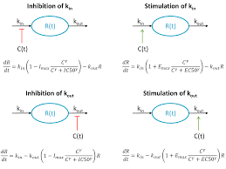
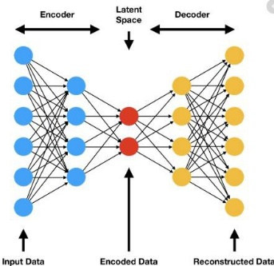
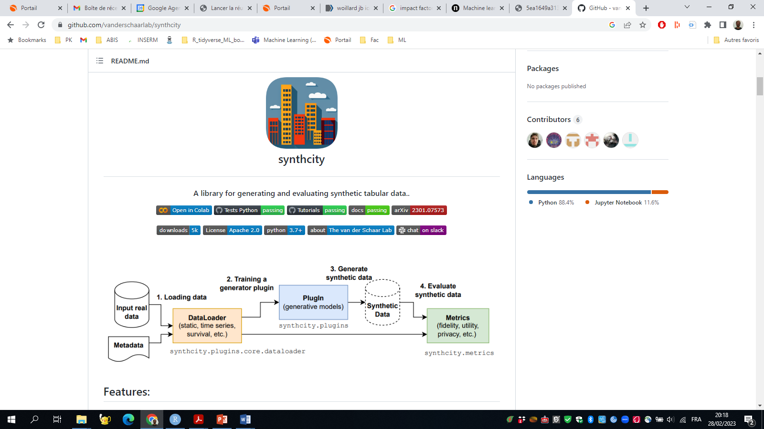
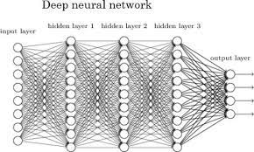
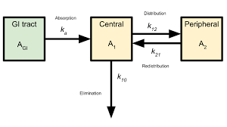
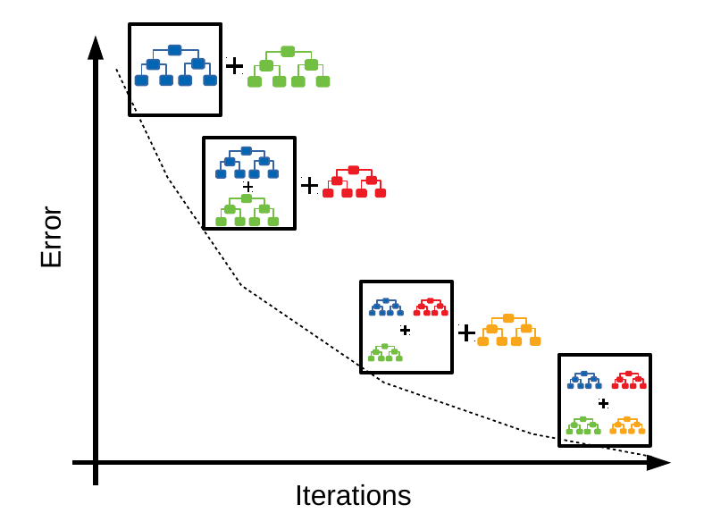
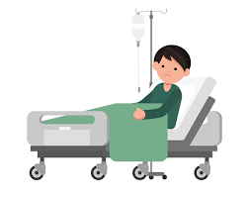
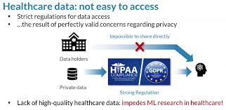

Digital Pharmacological Twins, DIGPHAT
Implementation of mechanistic Ordinary Differential Equation models from literature: Monte Carlo simulations to generate synthetic patients
INNOVATION
General Objective
Development of
Mechanistic ODE PK and PK/PD models
Data driven models
Development of a computational framework integrating mono-scale mechanistic or data-driven models into meta-models for improved predictive performance in treatment personalisation.
Transformation into synthetic data = de-identification
Multicentrer Data
Preclinical
Omics
Clinical trials
Cellular
Drug Selection
Exposure Targets
Optimising molecule choice and dosage
Defining therapeutic exposure goals
Treatment Combinations
Outcome Prediction
Selecting optimal therapy combinations
Forecasting efficacy and adverse effects

Slide 27




CASE STUDY
Meta-models applied to three major public health issues, integrating exposure-effects relationships across all scales.
Solid Organ Transplantation
Oncology
Life-long treatment timescales with complex exposure dynamics.
Kidney and lung cancer with direct toxicity mechanisms.
Antibiotherapy
Bacterial resistance in infectious endocarditis and invasive fungal infections, spanning days to weeks.
Originality: Drug concentrations serve as the link across all biological scales, integrating different time scales and toxicity mechanisms.

Slide 28
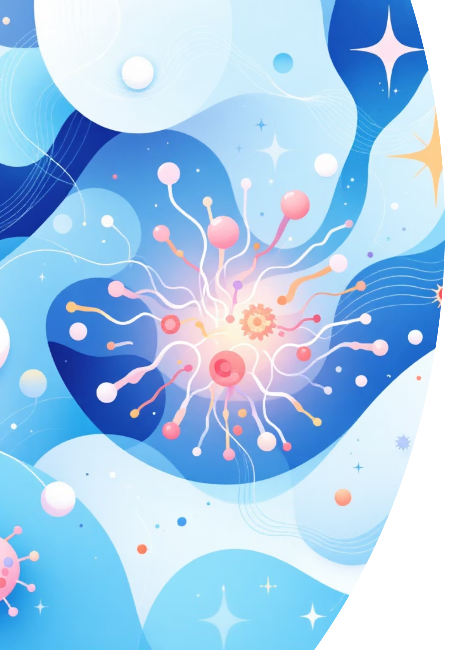
2. AI to advance Regulatory Assessment
HORIZON-HLTH-2026-01-TOOL-03 supports a paradigm shift in biomedical research and safety assessment by integrating New Approach Methodologies (NAMs) across the entire research and regulatory spectrum.
In-Vitro Systems
Human ex-vivo assays, organoids, and tissue models
providing human-relevant data
Organs-on-Chips
OoC systems and iPSC applications for advanced biological modelling
Digital Tools
- Virtual twin tools, in-silico methods, and AI-driven modelling for
predictive assessment.
- From basic discovery to clinical application and regulatory testing of medicinal products, medical devices, and industrial chemicals.

Slide 29
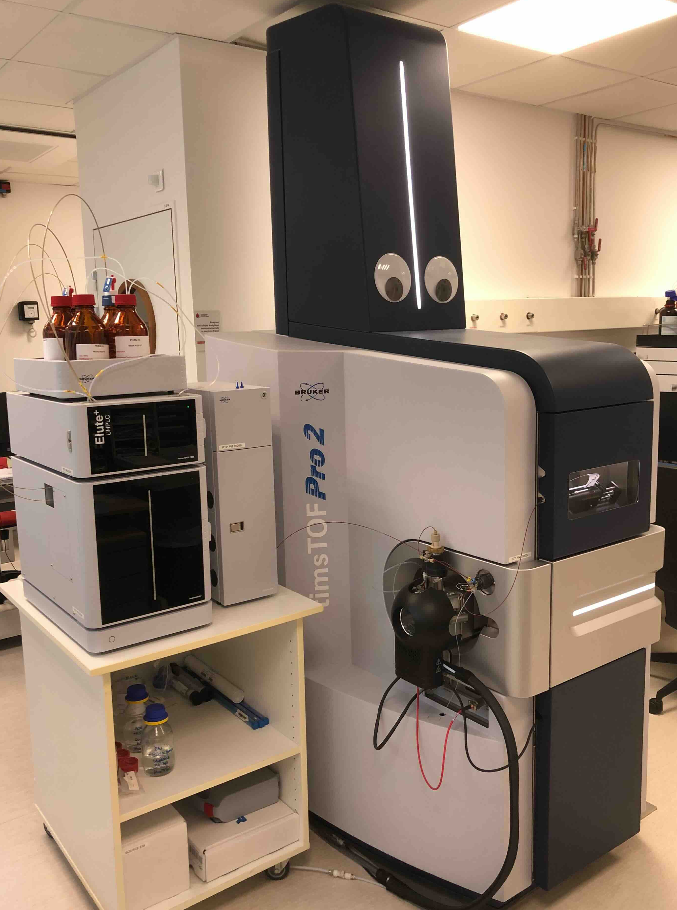
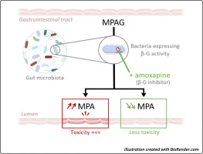
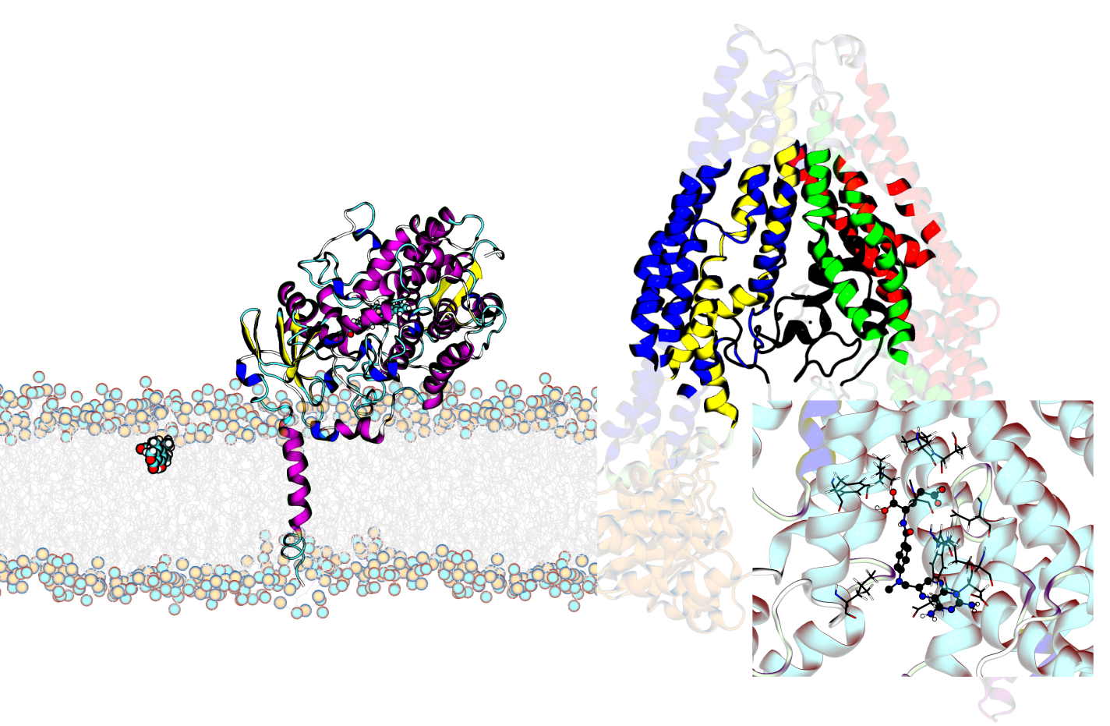
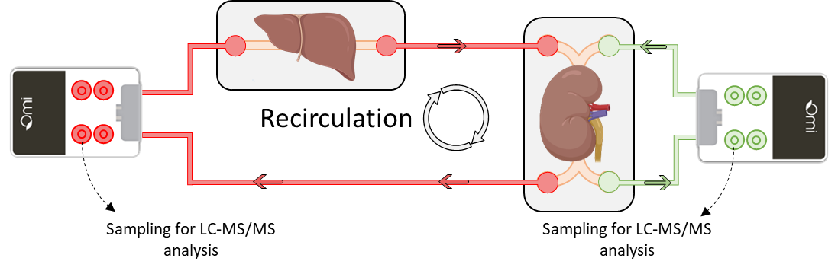
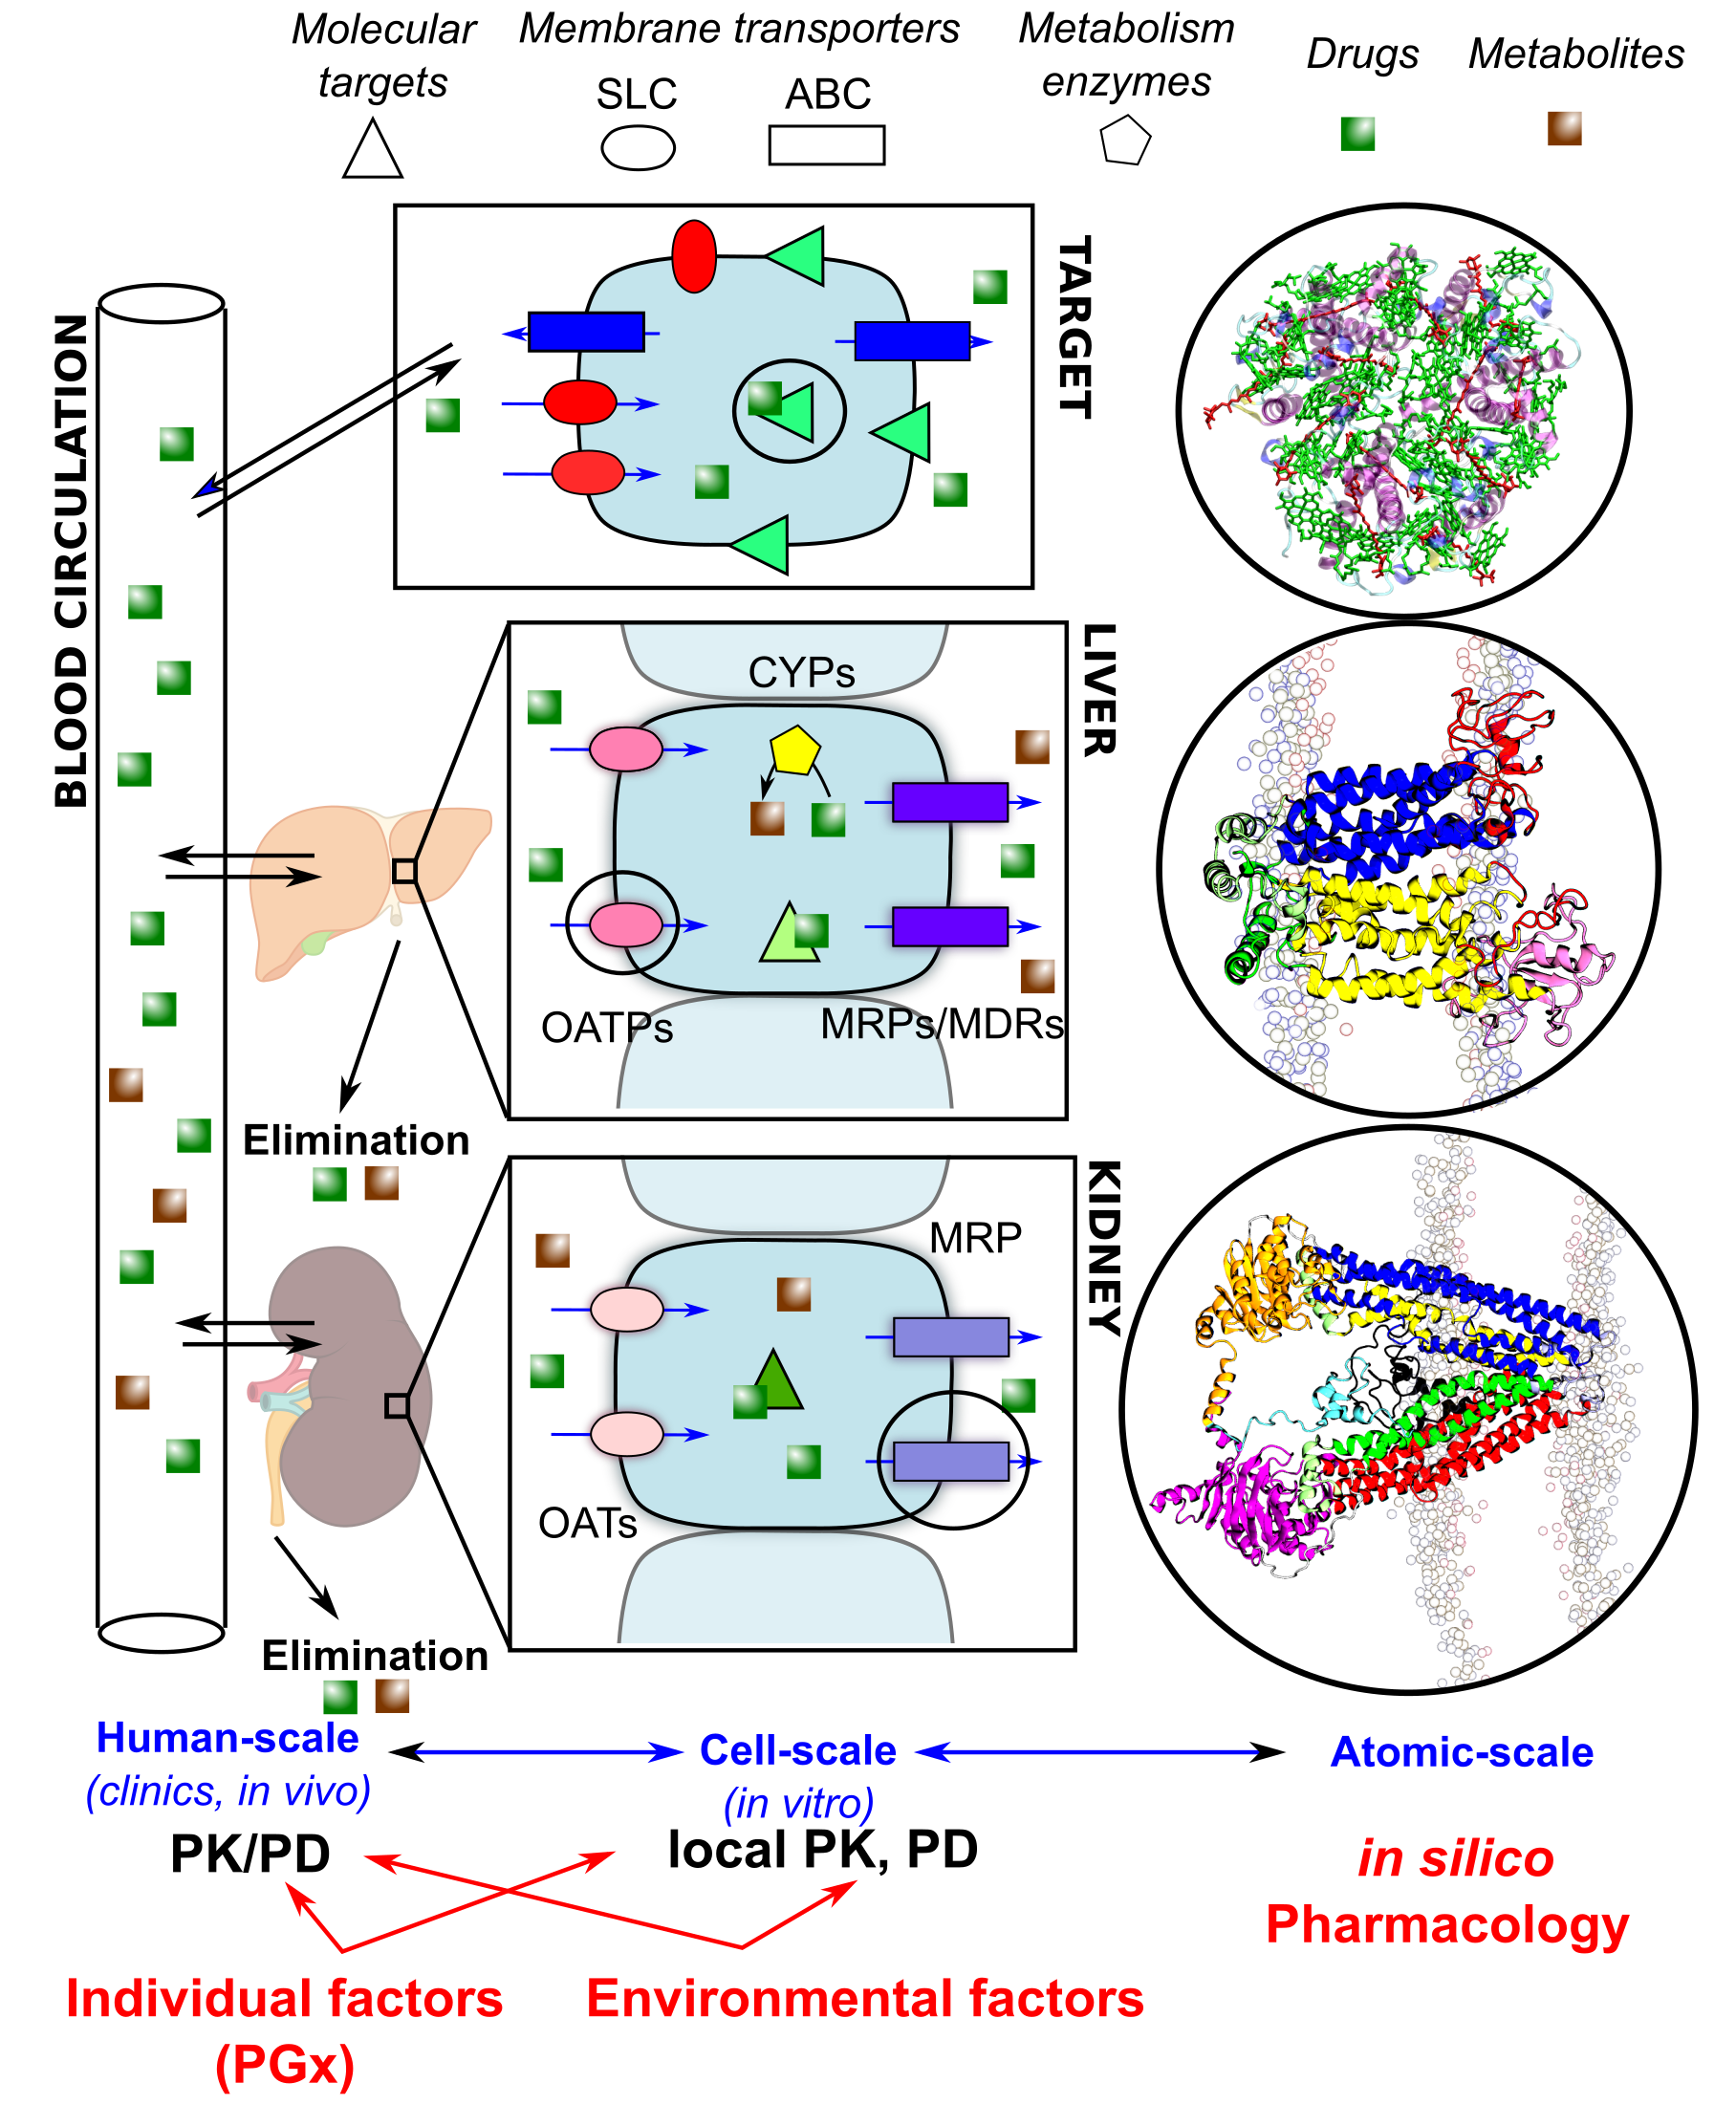
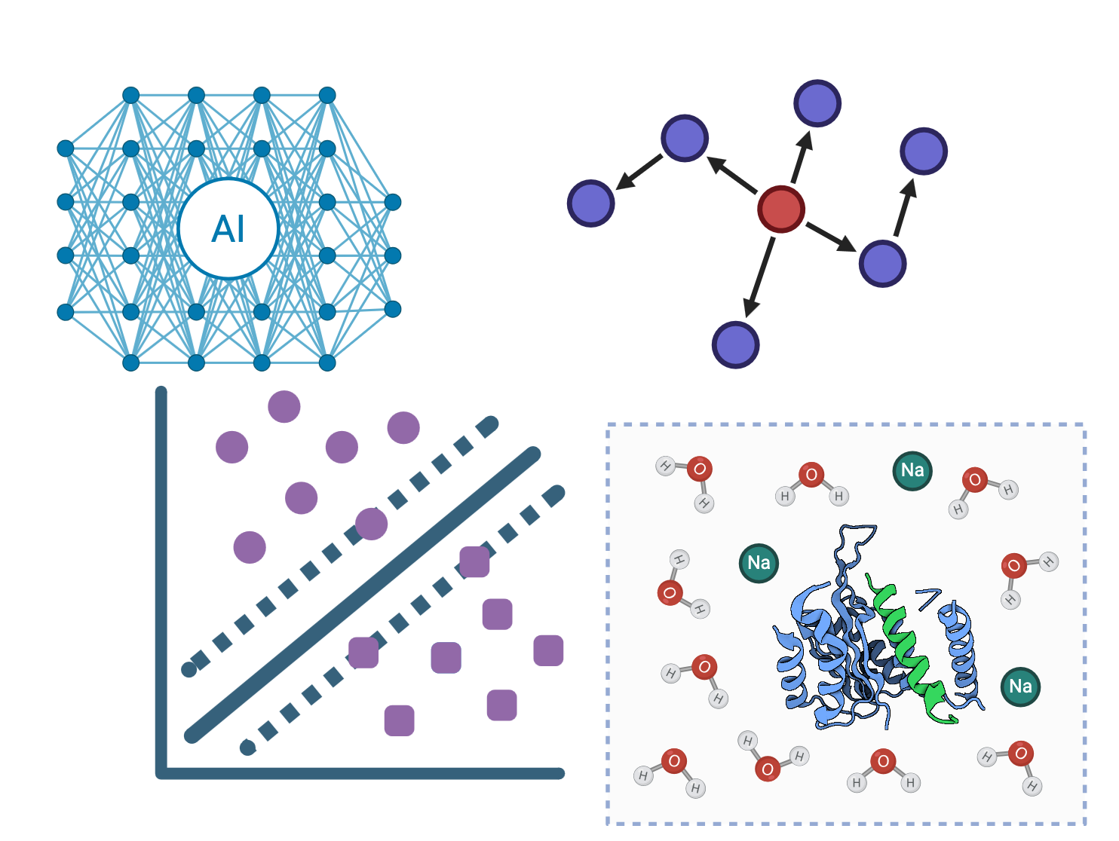
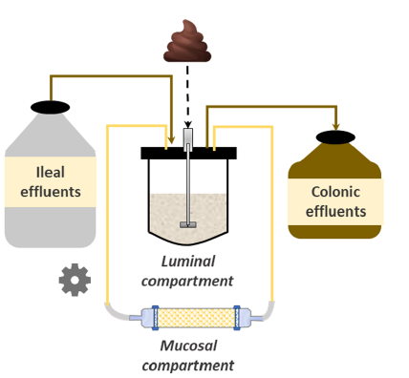
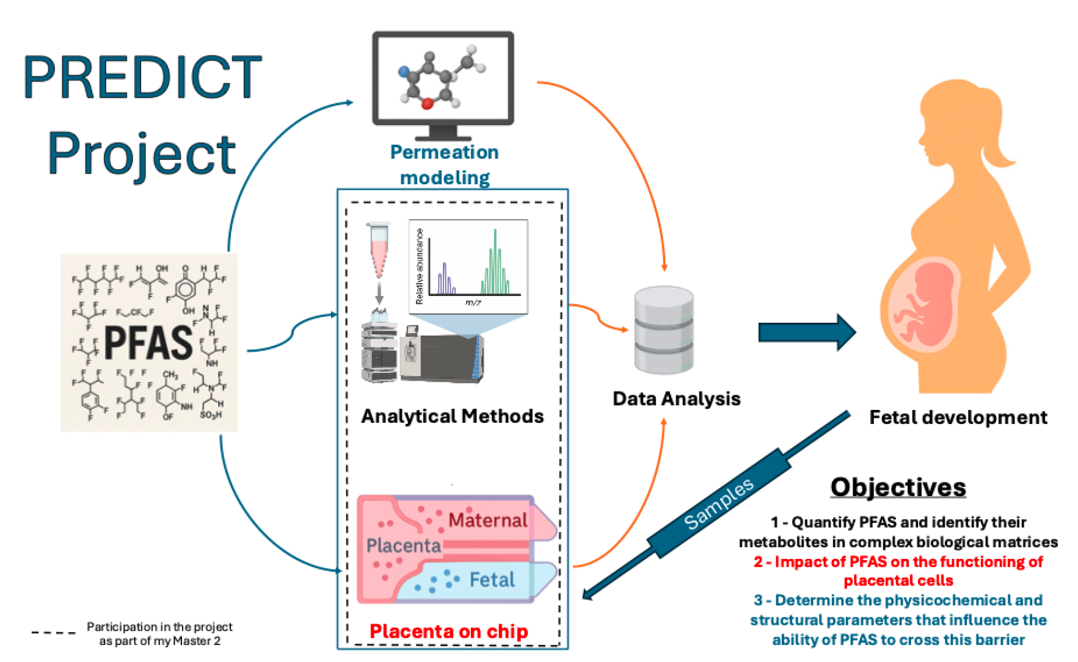
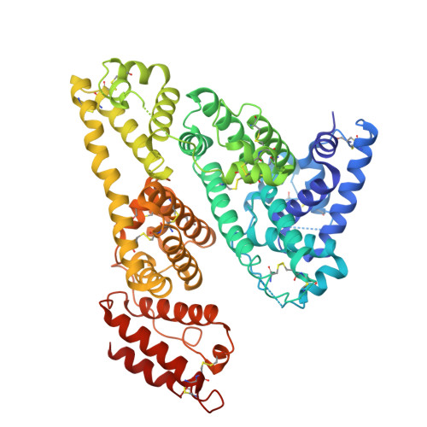
CINAPT: Combining NAMs to Advance Regulatory Pharmacology and Toxicology
Virtual twin of NAMs pipeline to predict human effects
Training with:
- failed & successful drugs
Application to:
Academic drug candidates
Environmental pollutants (PFAS and degrad. prod.)
Pharmaco-microbiomics
Identification of Molecular Initiating Events (MIEs)
In silico ADME
(and DDIs)
ADMET on-chips
Biomarkers of xenobiotic effects
Liver-kidney-OC
Proteomics, metabolomics, HRMS
Xenobiotic binding/competition
Artificial colon
Protein PTMs as biomarkers of organ toxicity
Microbiome-mediated metabolism and dysbiosis
Placenta-on-a-chip
Classifiers of xenobiotic/
protein interactions
Virtual cells of PK interest
Notes:
prot

